Slide 1
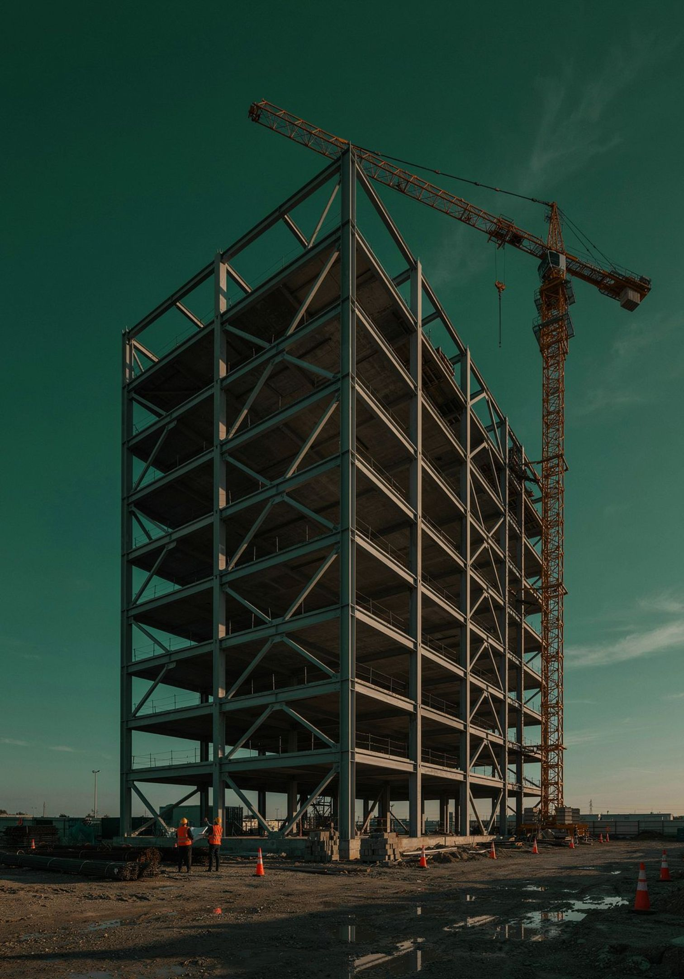
Meet thw new Kid on the block in Project Control
The Total Dispute Control System & Programme
A state-of-the-art, best-in-class system designed to identify, control and resolve construction disputes—before they disrupt the project, drain cash flow or escalate into costly proceedings.
control and resolve construction disputes—before they disrupt the project, drain cash flow or escalate into costly proceedings.
The new standard in construction dispute prevention and avoidance — built for contractors who cannot afford to lose what they have already earned.
FOR MAIN CONTRACTORS · SUBCONTRACTORS · D&B FIRMS · CIVIL & M&E

Slide 2
Stop Construction Problems Before They Become Expensive Disputes
Construction disputes rarely begin in the courtroom. They begin on the project — quietly, incrementally, and often invisibly to the team managing daily operations.
A verbal instruction is given but never confirmed in writing
A notice is issued late — or not issued at all
Additional work is performed but the variation remains unvalued
Payment problems accumulate and the relationship with the employer slowly deteriorates
By the time lawyers are appointed, the dispute may already be months or years old. Documents are missing. Notices have expired. The contractor knows what happened — but can no longer prove the full amount it is entitled to recover.

Slide 3
Where Total Dispute Control Is Especially Valuable
This programme was designed for precisely the situations where contractual risk is highest and internal resources are most stretched.
Heavily Amended Contracts
Extensive Insurance Obligations
D&B Data Centre projects routinely carry 30+ amendments to the Standard FIDIC Yellow Book — each one a potential trap for the unprepared team.
Employer-imposed insurance and indemnity obligations require disciplined tracking to avoid costly gaps in coverage and responsibility.
Third-Party Property Risks
Multi-Subcontractor Sites
Works involving existing buildings or property belonging to others demand careful contractual and evidential management throughout.
When several subcontractors work on the same site simultaneously, the volume and complexity of claims exposure multiplies rapidly.
No In-House Claims Department
Substantial Deductibles or Exclusions
Most contractors do not have a dedicated insurance, contract or claims team. Total Dispute Control fills that gap directly.
Projects carrying material deductibles or policy exclusions require proactive evidence management from day one.

Slide 4
You may be entitled to the money. But can you still prove it?
What You Should Receive
What You Can Actually Prove
The contractor has performed substantial additional work. Delays were caused by the employer. Legitimate claims have accrued under the contract. The entitlement is real and the amounts are significant.
Without written instructions, properly issued notices, current valuations and contemporaneous site records, recovery becomes difficult — sometimes impossible — regardless of what actually occurred on the project.
Entitlement does not protect itself. It must be maintained through timely notices, proper records, disciplined follow-up and an operating system that keeps the contractor's position current throughout construction.

Slide 5
How Construction Disputes Develop: The Four Stages
Most serious construction disputes pass through four recognisable stages — each one making recovery progressively harder.
Stage 2: Notices Are Missed
Stage 1: Contract Not Converted into Project Instructions
A delay, obstruction, late drawing or change occurs. Everyone discusses it — but the formal contractual notice is forgotten or submitted after the contractual period has expired.
The project team receives a thick contract but cannot identify precisely who must issue each notice, when, to whom, and what happens if a deadline is missed.
Stage 4: The Working Relationship Breaks Down
Stage 3: Variations Accumulate Unresolved
Letters become aggressive. Payments are withheld. Positions harden. The parties stop solving project problems and begin preparing for a dispute.
Additional work is performed. Instructions remain verbal. Valuations are delayed. Supporting documents become harder to locate. The unpaid amount grows month after month.

Slide 6

A Dispute Control Manager for Your Project
Under the Total Dispute Control Programme, your company is assigned a dedicated Dispute Control Manager who works alongside your existing project team throughout the entire construction period.
Not a Replacement
Continuous Review
He does not replace your Project Manager, Commercial Manager, Quantity Surveyor or lawyer. He works with them.
His function is to keep the project's developing contractual and claims position under continuous, structured review throughout construction.
Early Detection
He detects signs of a developing dispute early — before positions harden, before deadlines expire, and before documents disappear.

Slide 7

What the Dispute Control Manager Does
The Dispute Control Manager ensures that critical contractual actions are taken at the right time — before the opportunity to act is permanently lost.
Ensures important contractual notices are not forgotten or issued too late
Identifies and properly records instructions received verbally or informally
Maintains a live Variation Log and follows through on unvalued additional work
Creates supporting documents while events are still happening and memories are fresh
Flags unanswered correspondence before it becomes evidence of employer default
Tracks payment and extension-of-time matters through to resolution
The purpose is not to produce more paperwork. The purpose is to prevent the contractor from losing money because the correct notice, record or contractual action was not taken at the correct time.

Slide 8
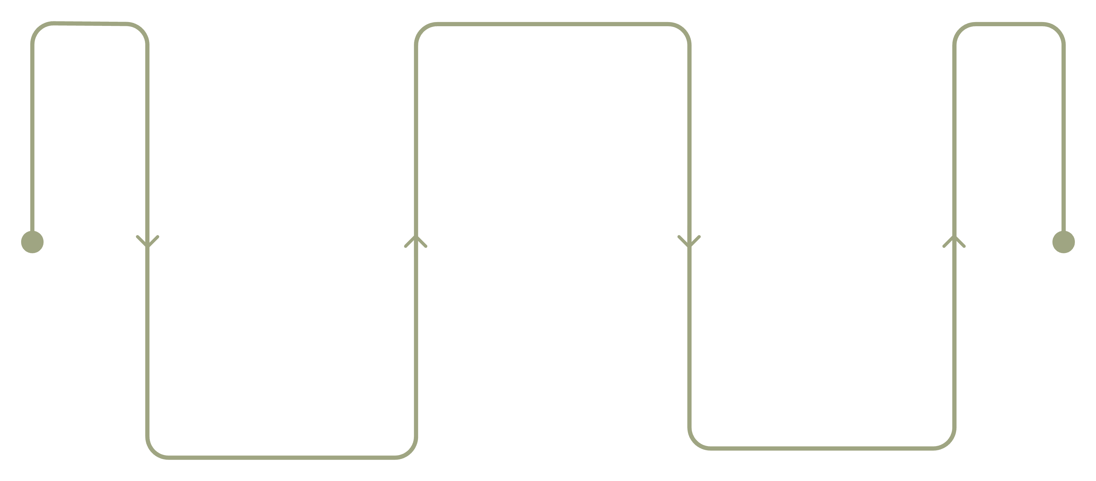
How Total Dispute Control Works: Three Operating Phases
Put Controls in Place
Deploy working documents and systems
Establish Position
Maintain Control
Assess contract and project status
Fortnightly reviews and action tracking
Each phase builds on the last. Control is established at the outset, reinforced through working documents, and maintained through a disciplined review-and-action cycle that operates for the duration of the project.

Slide 9
Phase One: Establishing the Project's True Position
Before any control system can operate, the actual state of the project must be understood — not the state that the project team assumes or hopes it is in.
New Projects
Projects Already Under Construction
For a newly awarded project, the important contract requirements are translated into practical actions for the project team. The team learns what must be done, who must do it and what may be lost if it is not done correctly.
We examine what has happened from the date of award. We identify missed notices, unrecorded instructions, outstanding variations, document gaps, payment problems and claims requiring immediate attention. This tells us where the project actually stands today.

Slide 10
Phase Two: The Control Documents
Depending on the selected service level, the project is equipped with a suite of working documents maintained throughout construction — not prepared once and filed away.
Contract Readiness Map
Notice Control System
Explains what the team must do, when and by whom — translating contract obligations into operational instructions.
Records every important notice, response deadline and contractual trigger point throughout the project.
Authority Matrix
Live Variation Log
Shows who may give and accept instructions on the project — preventing uncontrolled verbal authorisation.
Tracks all additional and changed work from instruction through to final valuation and payment.
Evidence Map
Relationship Barometer
Identifies the documents needed to support each developing claim — built while those documents can still be created or retrieved.
Monitors deterioration in the employer–contractor relationship as an early warning indicator of escalating dispute risk.

Slide 11
Phase Three: Maintaining Control Throughout Construction
A structured review is conducted at intervals of no more than two weeks. Every required action is entered into the Action Register with a responsible person and a deadline assigned.
01
02
Review important correspondence received and issued since the last session
Identify events requiring contractual notices before deadlines expire
03
04
Examine variations, additional work, payment and extension-of-time matters
Check documents required to prove each developing claim
05
06
Follow up all actions outstanding from the previous review
Assess changes in the working relationship with the employer
Nothing important is allowed to disappear into meeting minutes, email chains or the pressure of daily site operations.

Slide 12
THE TWO STAGES
EUREKA & HERCULES: Two Stages of Total Control
EUREKA — Understanding the Contract Before Problems Begin
HERCULES — Maintaining Control During the Project
Operates throughout construction through the disciplined review-and-action cycle. Notices are monitored. Variations are followed through. Correspondence is reviewed. Records are checked. Payment and delay matters are tracked. The relationship with the employer is continuously assessed. HERCULES prevents the control established by EUREKA from being lost as the project becomes busier and more difficult.
Implemented at or shortly after contract award. EUREKA converts the contract from a legal document sitting in a file into practical instructions the project team can follow. The team is shown what must be done, who must do it, when it must be done and what may be lost if it is not done correctly. Control is established from the outset.

Slide 13
He Is Not a Lawyer Waiting for a Dispute
"Traditional dispute services normally begin after the parties are already in conflict. Total Dispute Control begins earlier."
This is a construction management and commercial-control service — implemented by the people managing the project and supported by an experienced construction claims professional. It is not a legal service and it is not retrospective.
Objective One
Objective Two
Manage the project so well that arbitration becomes unnecessary.
Where a dispute cannot be avoided, enter it with properly issued notices, current variation records and contemporaneous evidence — not missing documents and expired deadlines.

Slide 14
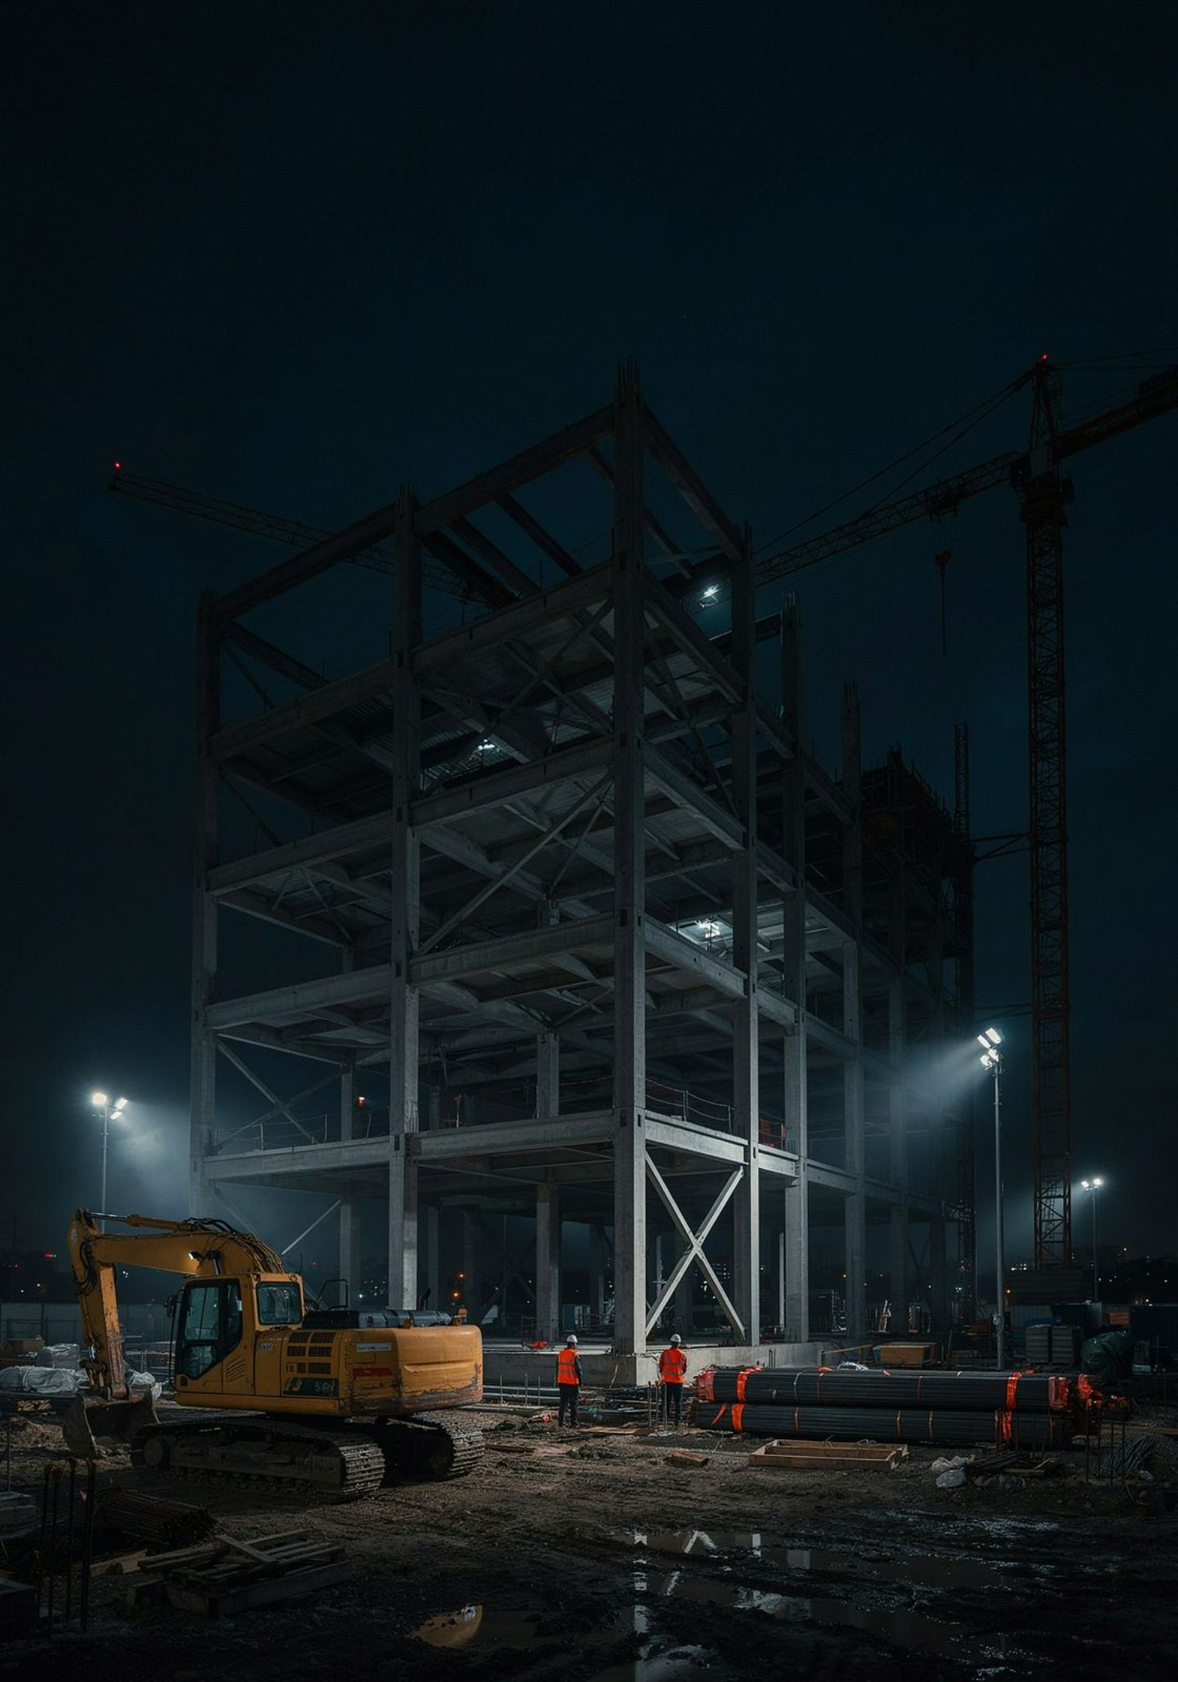

For Projects Already in Difficulty
Total Dispute Control can also be introduced after construction has commenced — including on projects where the situation has already become difficult or adversarial.
The first step is a retrospective examination of the project. We establish which notices were required and which were issued, which deadlines may have been missed, which variations remain unrecorded or unvalued, which payments remain outstanding, and whether the working relationship is approaching a serious dispute.
Not every past mistake can be corrected. However, many developing problems can still be contained if identified early enough. The longer the review is delayed, the more difficult it becomes to recover missing documents, reconstruct events and protect the contractor's position.

Slide 15
Who Should Use Total Dispute Control?
This programme is built for contractors operating in high-pressure, high-risk environments where the gap between entitlement and recovery is real and costly.
Contractors Performing Additional Work
Contractors Facing Delayed Instructions
Regularly carrying out changed or additional work that generates variation and claims exposure throughout the project.
Experiencing delayed instructions, drawings, site access or payment — each of which requires timely contractual notices to preserve entitlement.
Multi-Subcontractor Projects
No Dedicated Claims Department
Managing several subcontractors and large volumes of correspondence across a complex site with multiple interfaces.
Operating without in-house claims expertise — and repeatedly reaching project end with unresolved variations and lost notices.
It is especially valuable to directors who do not want to discover at the end of a project that substantial sums cannot be recovered because the necessary action was not taken months earlier.

Slide 16

A Monthly Service — Not a One-Off Report
What You Receive
How It Is Structured
An operating system for controlling contractual claims and developing disputes throughout the entire project — supported by a designated Dispute Control Manager conducting structured reviews at required intervals.
The monthly service continues for the agreed period. Structured project reviews are conducted fortnightly. Urgent matters are escalated as they arise — not held until the next scheduled review. Where the service is provided as a benefit under an approved commercial arrangement linked to your Construction Insurance placement, the monthly Dispute Control service may be available without a separate advisory retainer, subject to applicable eligibility requirements.
Your company does not receive a report that is delivered once and then placed on a shelf. You receive continuous, active control.

Slide 17
Do not wait until the Final Account.
The end of the project is the worst time to begin discovering what happened during the project. By then, the evidence your company needs to recover what it is owed may no longer exist.
Notice Period Expired
Key Personnel Gone
The contractual window for issuing notices has long since closed. The entitlement cannot be pursued.
The employee who received the instruction has left the project. Firsthand evidence of what was agreed is no longer available.
Records Unavailable
Position Hardened
The subcontractor's contemporaneous records are no longer accessible. Critical supporting documents cannot be reconstructed.
The employer's position has hardened. Settlement that was possible six months ago is no longer on the table.
Total Dispute Control begins while the facts are still fresh, the documents still exist and corrective action can still be taken.

Slide 18
The Best Construction Dispute Is the One That Never Escalates
You should not have to wait for arbitration to find out where your project went wrong. You should know your contractual position while the project is still running.
Know which notices are due
Know which variations remain unpaid
Before deadlines expire — not after the opportunity has been permanently lost.
With a live log maintained throughout construction, not reconstructed at final account.
Know which documents are missing
Know when the employer's position is changing
While they can still be created or retrieved — not discovered absent when recovery depends on them.
Early enough to respond commercially and contractually before the relationship deteriorates beyond repair.

Slide 19

Know What You Are Owed. Preserve the Proof. Control the Dispute.
Speak to us about placing your current or next construction project under Total Dispute Control. A confidential project discussion costs nothing and may protect everything.
📅 Book a Confidential Project Discussion
📞 Call or WhatsApp
Speak directly with a Dispute Control specialist Mr. Steven Chin about your specific project circumstances.
Arrange 30 minute private, no-obligation consultation to discuss your current project's contractual position.
✉️ Mobile : 6012-2673918
✉️ Email : lhchin@gmail.com
Send us your project details and we will respond promptly with a proposed approach tailored to your situation.

Slide 20
Important Notice
Total Dispute Control is a construction contract-administration, commercial-control and claims-advisory service. It does not constitute legal representation and does not guarantee the recovery of any particular claim or the avoidance of every dispute.
Where formal legal advice, arbitration or litigation becomes necessary, the contractor should appoint an appropriately qualified lawyer or other professional advisor.
Any insurance matter remains between the contractor, the insurer and the appointed loss adjuster. Our role, if requested, is limited to transmitting relevant communications or documents between the parties. We do not determine insurance coverage, adjust insurance claims or make decisions on behalf of the insurer, loss adjuster or contractor.

